Slide 1
HEALTHCARE ANALYTICS
Medallion Lakehouse Platform
KPI
Bronze → Silver → Gold, governed by an automated data-quality gateway,
orchestrated end-to-end by Apache Airflow, delivered to Power BI.
Capstone Project — Data Engineering · Updated October 2026
Mo Amer

Slide 2
PROJECT OVERVIEW
What This Platform Does
1
2
3
4
Extract
Govern
Model
Deliver
Pulls five operational tables (patients, doctors, appointments, treatments, billing) live from a Neon PostgreSQL source via PySpark JDBC.
Every row passes an automated Data Quality Gateway — uniqueness, referential integrity, domain rules, financial sanity — before it's trusted.
Clean data is reshaped into a proper star schema: four dimensions, two facts, with revenue variance calculated and independently verified.
A redesigned 3-page executive Power BI report — filters panel, labeled KPI cards, data labels and a live “data last refreshed” stamp — refreshed automatically by Airflow the moment the pipeline finishes and reconciles.
Source: 5 Neon tables · Layers: Bronze / Silver / Gold + Quarantine · Orchestration: 6-task Airflow DAG (Celery + Redis) · Output: 3-page Power BI report
Healthcare Analytics & Lakehouse Platform
2

Slide 3
ARCHITECTURE
Medallion Lakehouse Architecture
Neon
PostgreSQL
BRONZE
SILVER
GOLD
Power BI
→
→
→
→
source
raw · immutable · append-only
clean · deduplicated · validated
star schema
3-page report
QUARANTINE
rejected rows + reason logs
Every layer lives on MinIO (S3-compatible object storage) and is written with PySpark using the S3A connector. Gold is additionally written back to Neon Postgres — the serving layer Power BI reads from — and exported as local Parquet for ad-hoc analysis.
Healthcare Analytics & Lakehouse Platform
3

Slide 4
TOOLS & PLATFORMS
Technology Stack
Neon PostgreSQL
MinIO
PySpark
Parquet
Source database
S3-compatible object storage
Extraction, cleaning, transformation
Storage format across all layers
Apache Airflow
Docker Compose
Custom DQ Gateway
Power BI
CeleryExecutor + Redis orchestration
Reproducible local deployment
Data quality & governance
Redesigned 3-page report
Healthcare Analytics & Lakehouse Platform
4

Slide 5
GOVERNANCE
The Data Quality Gateway
Uniqueness
Primary keys must be non-null and unique; re-ingested duplicates resolved by latest ingestion time.
BRONZE (raw)
Date Sanity
appointment_date cannot be set in the future relative to execution date.
Positive Financials
billed_amount and treatment_cost must be strictly greater than zero.
DQ GATEWAY
Domain Enums
payment_status must be one of Paid, Pending, Failed, Refunded.
SILVER
QUARANTINE
Referential Integrity
Every foreign key must resolve to a real parent row in Silver.
Every rejection is logged with a full reason and timestamp — nothing is silently dropped.
Healthcare Analytics & Lakehouse Platform
5

Slide 6
DIMENSIONAL MODEL
Gold Layer — Star Schema
dim_patients
dim_doctors
dim_treatments
dim_date
fact_appointments
fact_billing_treatments
appointment_id · patient_id · doctor_id · date_key
status · is_noshow · reason_for_visit
bill_id · patient_id · treatment_id · doctor_id
billed_amount · treatment_cost · revenue_variance
revenue_variance = billed_amount − treatment_cost
Healthcare Analytics & Lakehouse Platform
6

Slide 7
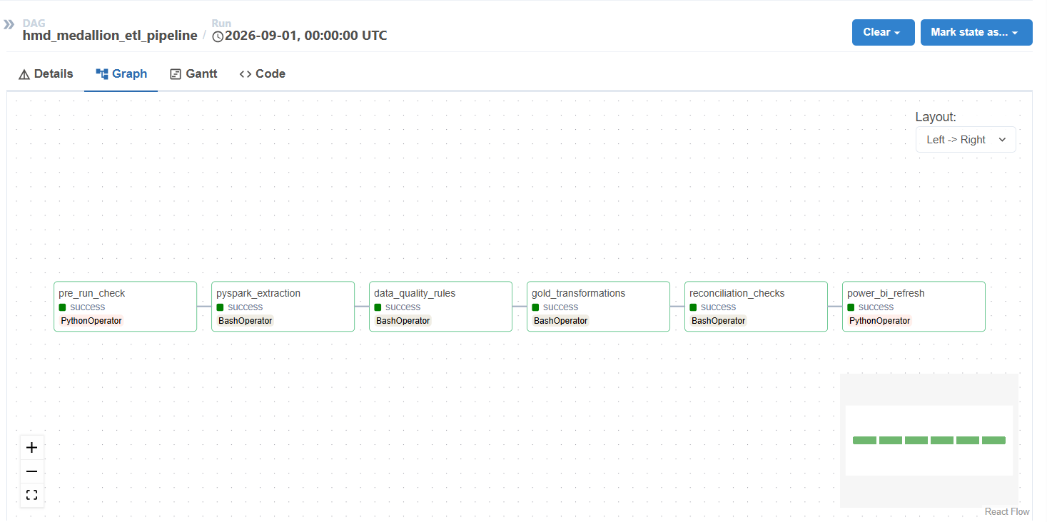
APACHE AIRFLOW
End-to-End Orchestration
1
pre_run_check — live Neon + MinIO health & bucket check
2
pyspark_extraction — Bronze ingestion
3
data_quality_rules — Silver DQ Gateway
4
gold_transformations — star schema build
5
reconciliation_checks — fails the run on any mismatch
6
power_bi_refresh — triggers the Service dataset refresh
All 6 tasks succeeding end-to-end, including the Power BI refresh trigger
Healthcare Analytics & Lakehouse Platform
7

Slide 8
WHAT'S NEW
Updates — October 2026
1
2
3
4
Report Redesign
Live Refresh Stamp
Gold → Neon Serving
Celery + Redis
White branded header on all three pages, a dedicated Filters panel, KPI cards with visible labels, $K data labels, and Refresh / Clear Filters controls.
A new 'Data Last Refreshed' DAX measure (FORMAT(NOW())) replaces the static timestamp and updates automatically on every model refresh.
The Gold star schema is now also written back to Neon Postgres, and Power BI reads public.* tables through the Python connector — no hard-coded local paths.
Airflow moved from LocalExecutor to CeleryExecutor with a Redis broker, SMTP alert variables, and a volume-mounted Gold export at /opt/airflow/output.
All report JSON validated · Reconciliation green · 48 semantic-model & report files parse cleanly
Healthcare Analytics & Lakehouse Platform
8

Slide 9
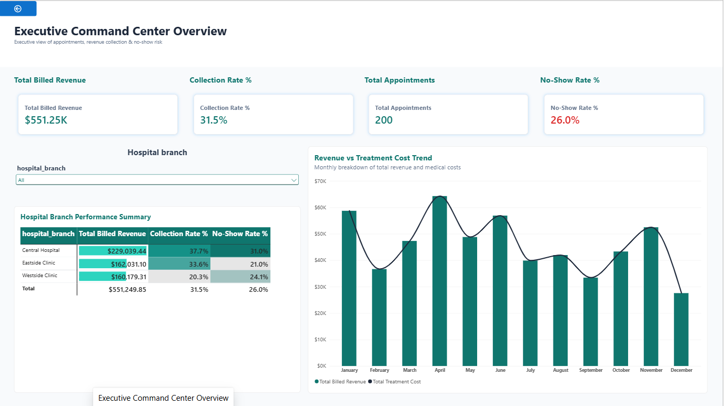
POWER BI — PAGE 1
Executive Command Center Overview
Healthcare Analytics & Lakehouse Platform
9

Slide 10
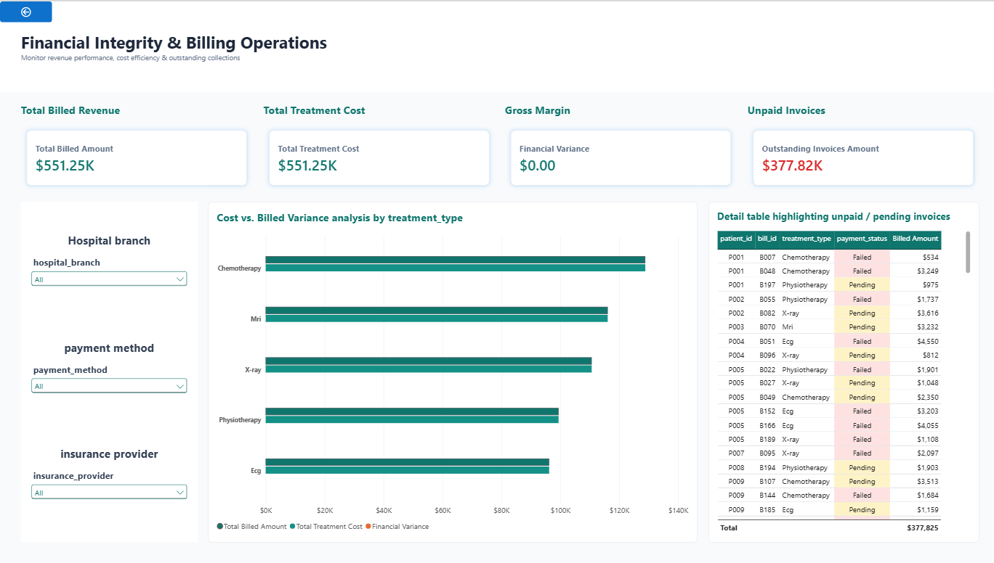
POWER BI — PAGE 2
Financial Integrity & Billing Operations
Healthcare Analytics & Lakehouse Platform
10

Slide 11
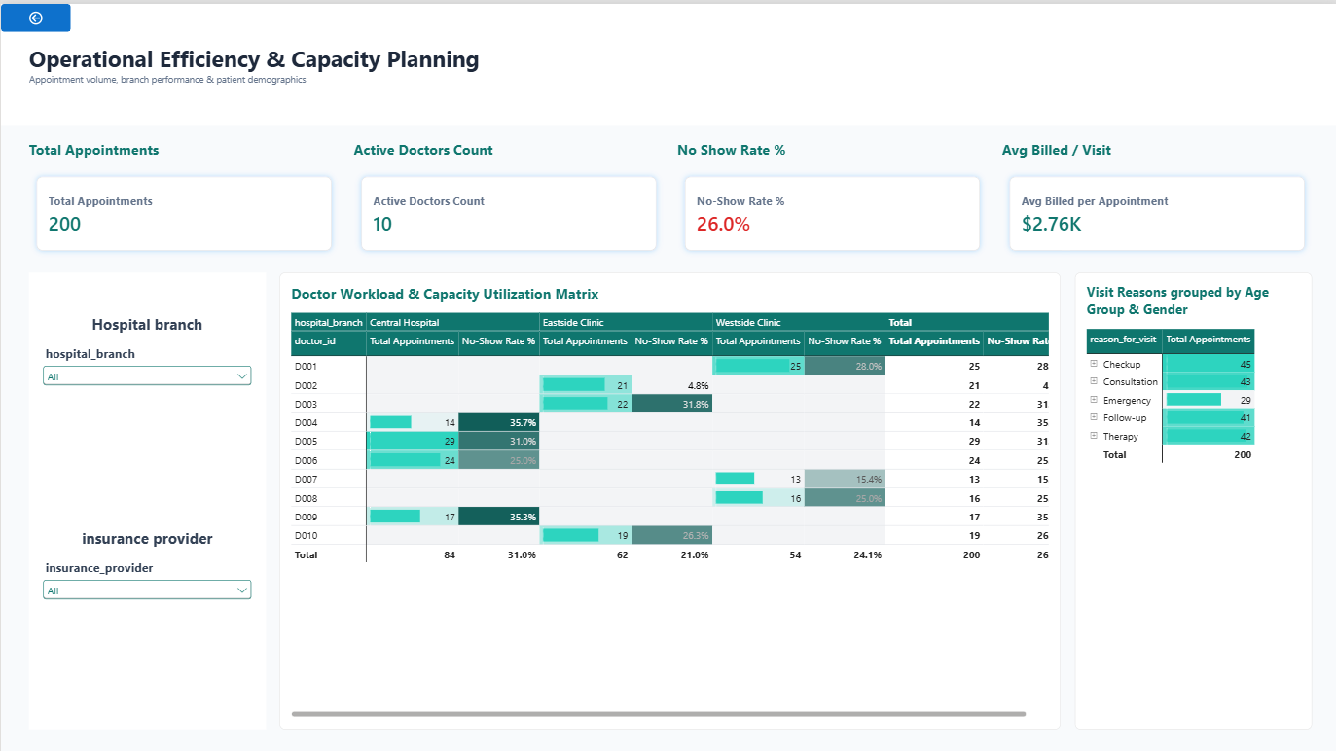
POWER BI — PAGE 3
Operational Efficiency & Capacity Planning
Healthcare Analytics & Lakehouse Platform
11

Slide 12
RECONCILIATION & INTEGRITY
Zero Silent Data Loss
✓
✓
✓
Bronze → Silver
Silver → Gold
Formula Sanity
Raw Bronze row count and financial sum must exactly equal Silver + Quarantine.
Row counts and financial sums must match exactly — this join is lossless by construction.
SUM(revenue_variance) is independently recomputed as SUM(billed_amount) − SUM(treatment_cost) and compared.
Any mismatch fails the Airflow task immediately — a broken pipeline never silently reports success, and Power BI never refreshes on unreconciled data.
Healthcare Analytics & Lakehouse Platform
12

Slide 13
BUILT ON A FOUNDATION OF
Governed Data, Verified Twice
Automated data-quality gating, end-to-end reconciliation, and a fully orchestrated Airflow pipeline — from a live operational database to an executive-ready Power BI report.
Thank you.
Mo Amer — Healthcare Analytics & Lakehouse Platform Capstone

